Slide 1




Launch Into Your Future
Choosing to Enlist
Is Military Service the Right Path for You?

Slide 2

Today’s Objectives
By the end of today’s lesson, you will be able to
Describe military service as a postsecondary pathway option.
Compare different ways to serve in the military.
Explain the enlistment process.
Evaluate whether military service aligns with your own goals and values.

Slide 3
Warm-up
Which sounds most exciting?
Travel the world
Learn a specialized career
Earn money for college
Serve your community
Be physically challenged
Work as part of a team
Which of these do you think military service can provide?
Notes:
HInt: The answer is all of them. ;)

Slide 4
Myth or Fact?
In Part 1 of your Workbook, indicate whether the offered statements are Myths or Facts.

Slide 5
Military service only means fighting in wars.
MYTH

Slide 6
Everyone has the same job.
MYTH

Slide 7
The military can help pay for college.
FACT

Slide 8
You have to be in perfect physical shape before joining.
MYTH

Slide 9
There are hundreds of different career fields.
FACT

Slide 10

Why do people enlist?
Which of these would motivate you?
✔ Pay for college
✔ Learn career skills
✔ Travel
✔ Build leadership
✔ Gain discipline
✔ Receive healthcare and benefits
✔ Serve their country
✔ Earn a steady paycheck/cash bonuses
✔ Become part of something bigger than themselves
Many military careers translate directly into civilian jobs, including cybersecurity, aviation, healthcare, engineering, logistics, IT, mechanics, law, and human resources.

Slide 11
YOUR TURN
In Part 2 of your Workbook, reflect on the reasons you might have to enlist in the military.

Slide 12
What jobs exist in the military?
There are over 150 different career specialties in the Army alone.
Cybersecurity
Aviation
Healthcare
Business
Technology
Construction
Intelligence
Communications
Human Resources
Mechanics
Engineering
Law Enforcement
In fact, the military is one of the largest employers in the world.

Slide 13
YOUR TURN
In Part 3 of your Workbook, reflect on your top careers of interest.

Slide 14
Student Scenarios
Student A: "I want to become a nurse."
Student B: "I can't afford college."
Student C: "I want to work in cybersecurity."
Student D: "I don't know what career I want."
DISCUSS AT YOUR TABLE: Would military service help? Why?
Notes:
Answer: Yes. The military would assist Student A in becoming a nurse, Student B pay for college, Student C work in cybersecurity, and Student D explore careers of interest, especially after meeting with a recruiter and taking the ASVAB which would help a lot with placement.

Slide 15
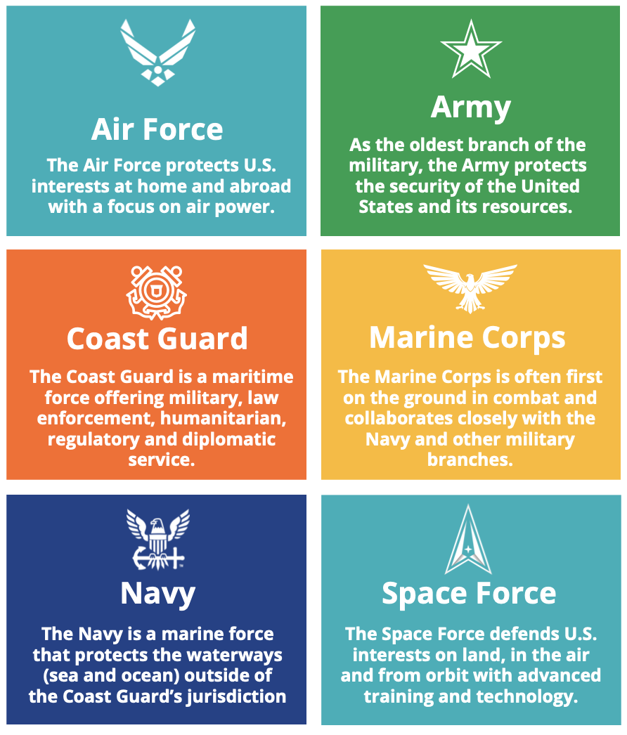
The 6 Branches
of the
U.S. Military
Although each branch has a unique mission, all offer education, training, career development, and opportunities to serve.

Slide 16
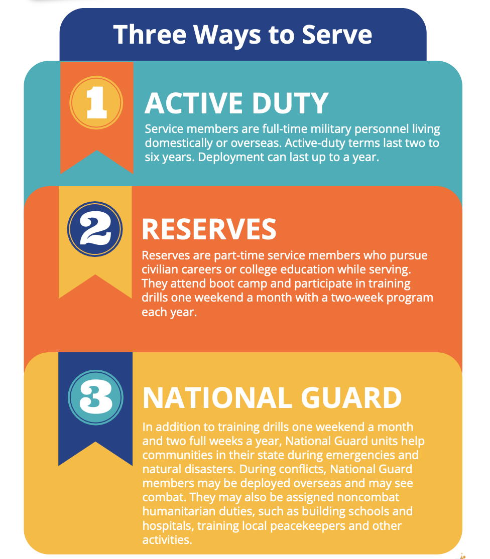
Notes:
Ask: “What appeals to you about each option?”

Slide 17
How does someone enlist?
STEP
01
Research careers and military branches to know which one(s) to pursue.
STEP
05
Choose a career field.
STEP
02
Meet a recruiter.
STEP
06
Sign enlistment contract.
STEP
03
Take the ASVAB.
STEP
07
Basic Training.
STEP
04
Get your medical exam.
STEP
08
Career Training.
Notes:
Step 1: Don’t limit yourself to just one branch. Learn about the Army, Navy, Air Force, Marine Corps, Coast Guard, and Space Force to see which best fits your goals, values, and interests.
Step 2: Connect with a local recruiter to ask questions about roles, benefits, commitments, training, and career paths. Be honest about your goals and ask about educational opportunities. Contact information will be offered later in this session.
Step 3: The Armed Services Vocational Aptitude Battery (ASVAB) is a required test for enlistment. Your recruiter will schedule you.
Step 4: Stay physically fit. Military service requires physical fitness. Focus on staying healthy.
Step 5: Stay academically ready. Military service requires a high school diploma. Focus on attending school regularly and maintaining strong grades.
Step 6: Talk with family and mentors. Enlisting is a BIG decision. Discuss your interest with trusted adults, veterans, or teachers to understand the full commitment.
Step 7: Basic training or boot camp prepares military recruits for all elements of service: physical, mental, emotional.
Each of the military branches has its own training program, tailoring the curriculum to the specialized nature of its role
in the Military.
Step 8: Each branch has a wide range of jobs (many with civilian equivalents).

Slide 18
What is the ASVAB?
The Armed Services Vocational Aptitude Battery
https://www.officialasvab.com/
The ASVAB measures the following strengths to determine which military careers you qualify for:
Math
Science
Reading
Mechanical reasoning
Electronics
Problem solving
Higher scores generally qualify students for more career options.
Notes:
HInt: The answer is all of them. ;)

Slide 19
YOUR TURN
In Part 4 of your Workbook, try some sample ASVAB questions.
Notes:
Answer Key: 1 B; 2 D; 3 C; 4 D; 5 B; 6 C; 7 B; 8 A; 9 C; 10 C

Slide 20
ASVAB Success Tips
https://www.officialasvab.com/applicants/prepare/
From the website:
“The ASVAB Testing Program does not endorse any particular method of test preparation beyond recommending that examinees take a solid core of courses in mathematics, English, and science in high school and/or college.
Such academic preparation will help with performance on the Arithmetic Reasoning, Mathematics Knowledge, Paragraph Comprehension, Word Knowledge, and General Science subtests. Taking technical courses will also help with performance on the Auto Information, Shop Information, Electronics Information, and Mechanical Comprehension subtests.”
✔ Don't cram.
✔ Review math fundamentals.
✔ Take practice tests.
✔ Get enough sleep.
✔ Read carefully.
✔ Manage your time.

Slide 21
Could Military Service Fit You?
TURN AND TALK
What would you enjoy?:
Working on a team?
Physical challenges?
Following structure?
Travel?
Learning technical skills?
Serving others?
Why or why not?

Slide 22
Benefits vs. Commitments
Benefits
College funding
Steady income
Job training
Leadership
Healthcare
Travel
Commitments
Multi-year contract
Physical standards
Possible relocation
Time away from family
Following military rules
Deployment may be possible
A smart decision considers BOTH columns.
Notes:
After going through these, ask: “Which benefit is most valuable?” AND “Which commitment would be hardest for you?”

Slide 23
Questions to Ask Before Enlisting
The following are some questions you can ask when meeting recruiters.
What career can/will I train for?
What jobs transfer well to civilian careers? (Most of them do!)
What does a typical day look like?
Can I attend college while serving?
How long is my contract?
What education benefits do I qualify for?
What happens after my service?
Notes:
HInt: The answer is all of them. ;)

Slide 24
YOUR TURN
Working alone or with others who share common interests, use the links in the next slide to research military branches and/or careers.
You might start by researching military branches of interest, or you can use the link at the bottom of the slide to research careers and see what military branches offer opportunities for them.
Record your findings in Part 5 of your Workbook.

Slide 25
Recruiting Centers/Contacts/Websites
U.S. Air Force & Space Force
8245 B Dickerson Ln
Salisbury, MD 21801
443-365-3674
https://www.airforce.com/
https://www.spaceforce.com/
U.S. Coast Guard
40 West Plaza
6499 Baltimore National Pike
Catonsville, MD 21228
(206) 815-6105
https://gocoastguard.com/
https://www.uscg.mil/
U.S. Army
21141 Sterling Ave #6
Georgetown, DE 19947
(302) 259-7785
https://www.goarmy.com/
U.S. Marine Corps
8245 B. Dickerson Ln
Avalon Plaza Shop Center
Salisbury, MD 21804
(410) 742-2694
https://www.marines.com/
U.S. Navy
21141 Sterling Ave
Georgetown, DE 19947
(267) 410-9091
https://www.navy.com/
To research careers in the military, visit https://www.careersinthemilitary.com/home
Notes:
Note: These recruiting center locations are based on Zip Code 19947. Adjust for your location.

Slide 26
Next Steps
Complete Part 6 of your Workbook to consider your next steps.

Slide 27
Your future isn't decided today...
...but today is a chance to explore what might be possible.
Be curious. Ask questions. Explore your options.
The best decision is an informed decision.
Thank you for participating in Launch Into Your Future.

