Slide 1




Launch Into Your Future
Delaware Student Success
FAFSA Workshop

Slide 2

What do I need to fill out the FAFSA?
What is an FSA ID?
Who is considered a “contributor” on the FAFSA?
Do I have to fill out the FAFSA every year?
Notes:
Let your audience (students, families, etc.) know that this presentation will cover these primary frequently asked questions and give step-by-step directions for completing the FSA ID and FAFSA online, plus extra help where needed.

Slide 3
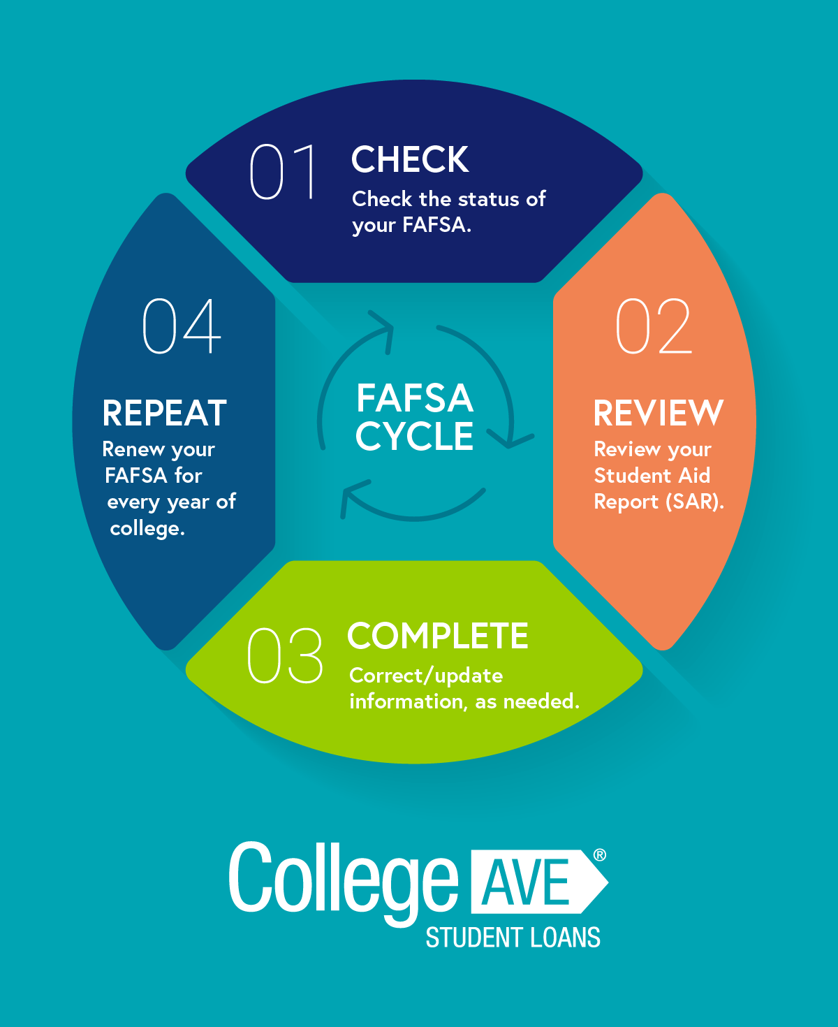
Your Gateway to College Funding
The FAFSA is mandatory for receiving any kind of financial aid → grants, scholarships, campus work-study jobs, & low-interest student loans.
Some colleges & universities use the FAFSA to determine their own school funded merit scholarships.
Notes:
Let your audience know that this is an application to see what you can receive in funding for your education. This can cover a variety of educational experiences and is mandatory to do so.
The next slides cover the reasons why.

Slide 4
Why Complete the FAFSA
Access to “free money” → federal grants, state grants, and institutional scholarships are not required to be paid back.
Federal student loans offer lower interest rates, flexible repayment plans, and better protections for borrowers.
Students can qualify for work-study jobs, which are available to undergraduate and graduate students to offset the costs of their educations.
Notes:
The next slides cover the reasons why addressed somewhat below.
Some students may say that they do not need to complete the FAFSA as their education is already funded, they are expecting merit or athletic scholarships from the schools they are applying to, or they do not intend to continue their studies yet.
Even if they already have money saved for college, students may find that they receive enough in grants or scholarships (free money…) that they can keep what they have saved for additional unexpected costs like books, parking, technology, auto insurance, etc.
All families have different dynamics and the FAFSA accounts for that. For instance, if a student has multiple siblings, that will impact their parents’ ability to pay for college and they may receive more in grants than loans. Additionally, if a student lives in a divorced family, oftentimes only one parent is the “contributor” on the application, which means the overall salary will be lower and may provide the student with more “free money” [i.e. grants & scholarships].
Students may say they do not want loans, but if there is a chance they will need any additional funds from loans, it’s best to complete the FAFSA as the interest rates on these are lower than privately funded loans like Sallie Mae.
If a student is not sure what they want to do yet or is not following a traditional plan, they should still complete the FAFSA to see what would be available to them and they can always return to it once they decide.

Slide 5
Why Complete the FAFSA
There are no income limits for the FAFSA, so even if your family has a higher income, you may still qualify for funding.
The application itself is free and all you need to do is plug in some information online - you may have heard it is a difficult process but it’s simpler than the Common App.
You are not obligated to take any funding offered.

Slide 6
No income limit
Apply early as it is first-come, first-served
Families with more than one child in college can receive more in grants and federal loans
It only takes 12 minutes on average to complete
You must apply every year to continue receiving the same funding
Filling out the FAFSA does not mean you are committing to the loans
You can send your profile to 20 colleges & universities
“Surprising” Facts about the FAFSA
Notes:
Let students know that ideally they will complete this application when it opens October 1 and send it to every school on their list by that point. Students can send their profile to other colleges & universities – up to 20 – at a later date if needed.

Slide 7
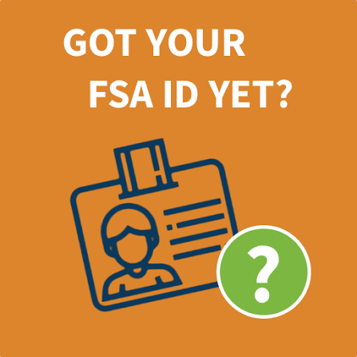
Step 1: Creating an FSA ID
First, gather all the materials you will need → Social Security Number (SSN) & personal contact information.
Next, go to StudentAid.gov and click on “Create Account.”
Enter your personal information then create a unique username & password that you will remember.
Notes:
Note to students about the first step → if you do not have a “professional” email address that you would like to use through college & after, you can create one now so you can use it for your FSA ID and for your FAFSA every year.
Remind students to use their legal name, no nicknames. All information should be entered as it appears on the student’s social security card.
Students will need to select four challenge questions in case you forget your username and/or password. It is recommended you also enable two-step verification since you are entering very private information

Slide 8

Step 2: Preparing to Begin the FAFSA
Gather all required information →
FSA ID
SSN
Driver’s license number
2025 tax returns & W-2 forms
Untaxed income records
Asset records
Your college list
Next, you will start your application by logging in and beginning the “official” form. [Note: Make sure you select the correct school year application.]
You will choose your role as “student” to launch the form.

Slide 9
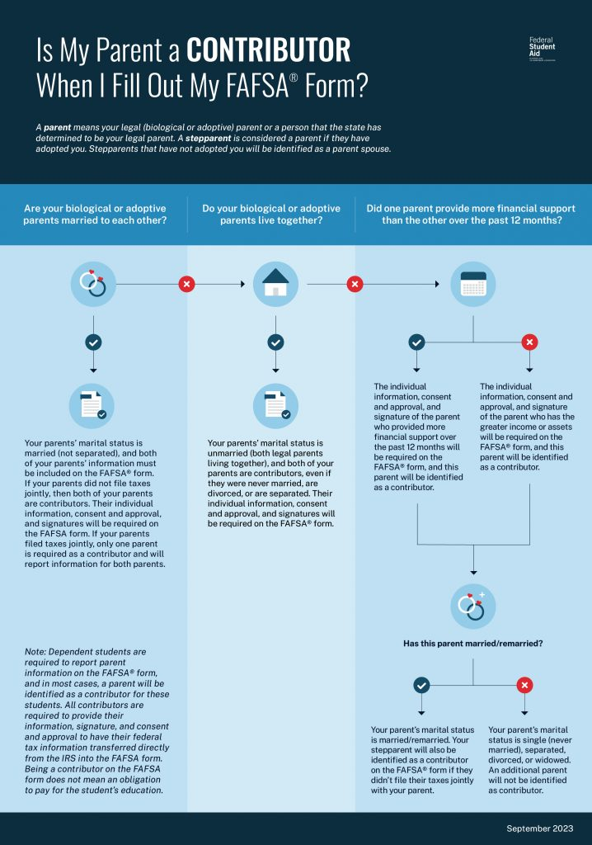
Step 3: Inviting Your Contributors
A contributor will help you complete the form.
First, identify who your contributor is → this is typically a biological or adoptive parent. You will need this person’s personal info & SSN.
Once you have entered their email address, the system will send an official invitation.
Notes:
If students ask you about who their contributor should be, there are a few key points to remember → they should first select whomever claims them on their W-2 form [in the case that they are only being raised by one parent or in the case of divorce, but this could be the legal guardian as well]. Since students complete this each year, they may change who a contributor is once they are in college, especially if they become independent of their legal guardian.
Students cannot submit their application until all contributors have completed theirs, so it is recommended that they sit down with their parents and complete the application together to make sure they meet the first-come, first-served situation.

Slide 10
Step 4: Consent to Financial Data Release
Reminder that you cannot submit your FAFSA until all contributors have completed their parts & clicked “approve” or “consent” on the financial disclosure tab.
In doing so, the IRS will automatically transfer your contributors’ tax details into the application [thus saving several steps].
You cannot refuse consent, as this information is what determines how much financial aid you can receive.

Slide 11

Step 5: Add Your Colleges
Select the college by name or by entering their school code.
Add all schools you are planning on applying to, even if you have not yet applied or been accepted.
The schools listed will automatically receive your financial data once your application has processed [similar to the SAT exam].

Slide 12
Step 6: Review & Submit
Finalize your application by reviewing the summary page
Sign the form electronically using your FSA ID
Submit the form and SAVE your confirmation page

