Slide 1



Launch Into Your Future
Surviving the
College
Application Process

Slide 2


In order to learn more about next week’s Launch into Your Future activities, please visit this webpage from the Delaware Higher Education Office.

Slide 3
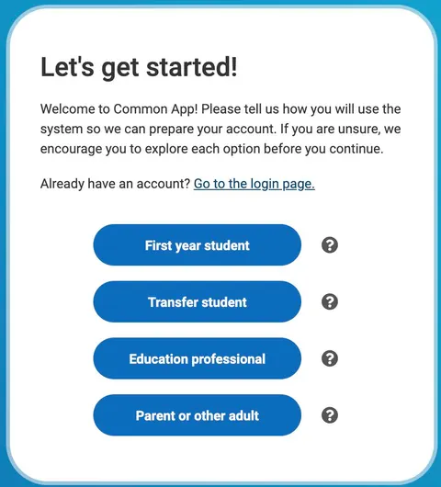
Before you go any further…
The first step in the process is creating a Common App account.
The Common App is an online application platform that is used by over 1,000 colleges & universities.
Go to the Common App to create your account as a first-time student.
Notes:
Some notes about the Common App v. Coalition.

Slide 4
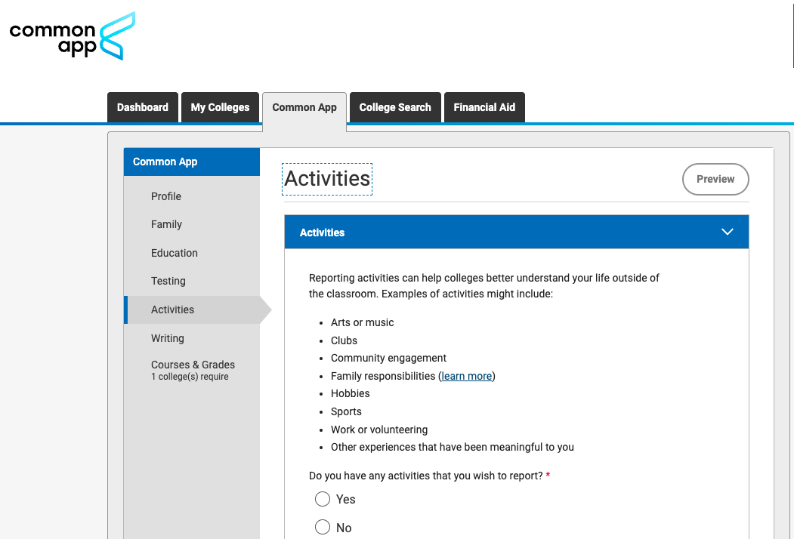
Now that you have created your account…
You need to know more about how the application works →
Dashboard: Tracks your progress & deadlines.
My Colleges: School-specific questions & recommendations.
College Search: Find & add schools to your list.
Common App: Fill in your main profile & activities.
Notes:
Some notes about the Common App v. Coalition.

Slide 5

Launch Into Your Future
Step 1: Start by reviewing the FAQs from the Surviving the College Application Process series.
These presentations will help you understand:
How to write for college applications
The different types of applications
What to expect during the overall application process
Step 2: Open the College Application Checklist from the same series and make your own copy to track your progress and stay organized.
Notes:
https://docs.google.com/document/d/19VJQDRtawIl5dj771bev4Bc_DBTAXivKxdsRyAXaHU0/edit?usp=sharing

Slide 6

These in-state and out-of-state colleges are waiving their application fees during Launch Into Your Future Month!
Waived Application Fees
Notes:
Once the Delaware Higher Education Office sends school counselors this year’s fee waiver PDF, please attach it to this slide for students.

Slide 7
Post-Secondary Plans: College
If applying to college is a part of your post-secondary plans, please consider the the following information as you enter your senior year →
College List → Have a balanced list of reach, match, and safety schools (around 6–10 colleges)
Campus Visits → Completed a few college visits (in-person or virtual) or made plans to visit during the summer
SAT/ACT → You took the SAT in March 2025, do you need to take it again this fall? [Note: Check to see your schools’ test requirements before you decide.]
Resume or Activity List → Create a draft of your activities, honors, and leadership roles for applications. [Note: If your list of extracurricular activities, experiences, etc. is lower than expected, what can you join this fall?]
Letters of Recommendation → Identify and ask teachers or counselors for letters of recommendation as needed. [Note: Check your schools’ requirements in the Common App before asking for too many.]
Personal Statement → Started brainstorming or drafting your college essay/personal statement
Financial Aid Awareness → Talk with family about college costs and started learning about FAFSA, scholarships, and financial aid. [Note: You will attend FAFSA workshops in October and learn more about scholarships during your school’s Launch Into Your Future week.]

Slide 8

Building a Wish List
A wish list helps you clarify your future goals → it encourages students to think about what they want in a college, including size, location, academic programs, and campus culture.
A list will help you stay organized → A focused list helps students keep track of application deadlines, admission requirements, and financial aid options.
Building a list might help you maximize your opportunities → A balanced list of reach, match, and safety schools increases the likelihood of getting accepted and receiving scholarships.
Most importantly, building your list now will help you reduce stress later → Planning ahead in your junior year gives you time to visit campuses, attend info sessions, and prepare strong applications in senior year.

Slide 9

Ways to Apply to College
Early Decision → This application is BINDING, which means, if you are accepted to the institution, you are expected to enroll.
Early Action → This is NOT BINDING, which means, if you are accepted to the institution, you do not have to enroll.
Both typically receive admission decision by January. This application is for students who absolutely know their #1 school choice. Assures the school of the applicant’s seriousness for enrolling in that school.
Regular Decision → This is NOT BINDING, which means, if you are accepted to the institution, you do not have to enroll.

Slide 10
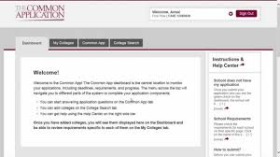
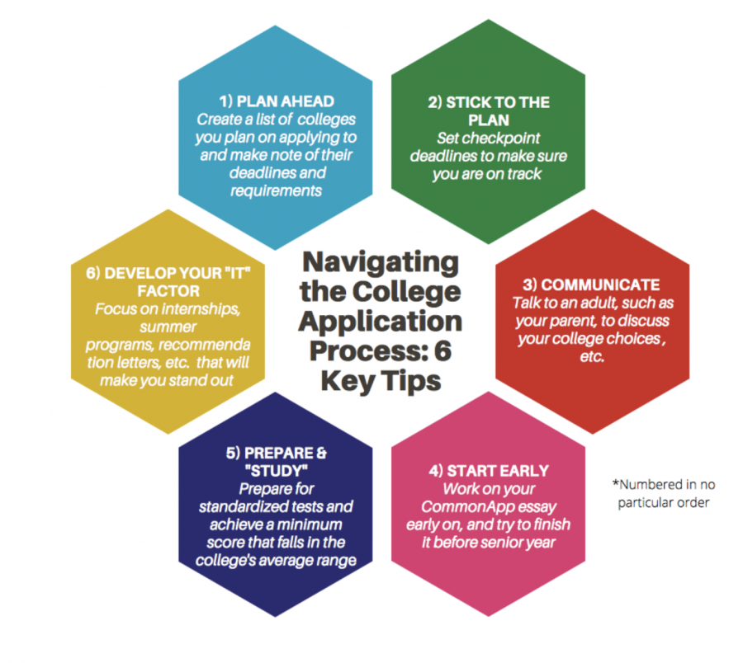
The Application
While there are multiple steps involved with applying to your ideal schools, there are plenty of resources out there, including the following that may help you with the process→
The College Application Hub → A resource for anything you will find in the application, including your personal statement.
If you do not have a resume to help guide you through building your Activities List in the Common App, use a resource like this one that helps you organize yourself.

Slide 11


No Experience with College Campuses?
In case you are still building your college wish list and visiting campuses, here’s some advice:
Start Local → Visit nearby colleges like the University of Delaware, Delaware State University, Temple University, or Towson University, even if you’re not planning to apply there. It helps you get a feel for different campus sizes and settings.
Take Virtual Tours → Many colleges offer free online tours and videos that show you classrooms, dorms, and campus life [Note: If prompted, enter your name/contact info for any tour or info session so you get “credit” from the school for your participation.]
Ask Questions → When visiting (in-person or virtually), ask about academic programs, student support, housing, and campus safety.
Go During the School Year → If possible, visit when classes are in session to see what student life is really like [Note: Once you narrow down your list, visit at different times of day/night to ensure you feel comfortable there.]
Bring a Notebook or Use Your Phone → Take photos and notes to help you remember what you liked or didn’t like about each school.
Talk to Current Students → They can give you honest insights about their experiences.
Attend a Campus Event or Info Session → These are great ways to learn about the admissions process and see how the college supports new students.
For help in touring, please use the College Visit Worksheet as a guide.

Slide 12

The Personal Essay/Statement
While it is YOUR personal statement, you may struggle to get started or how to pick a topic. Here are some suggested resources →
The Great College Essay Test
Listen to the College Essay Guy podcast
Writing Supplements

Slide 13
Post-Secondary Plans: Military
In the coming weeks, you will attend a full military panel to hear from multiple branches.
If you are interested in exploring now, here are some points to consider →
Don’t limit yourself to just one branch → Learn about the Army, Navy, Air Force, Marine Corps, Coast Guard, and Space Force to see which best fits your goals, values, and interests.
Meet with a Recruiter → Connect with a local recruiter to ask questions about roles, benefits, commitments, training, and career paths. Be honest about your goals and ask about educational opportunities.
Understand the ASVAB → The Armed Services Vocational Aptitude Battery (ASVAB) is a required test for enlistment. Ask your school counselor when it’s offered and consider taking a practice test now.

Slide 14
Post-Secondary Plans: Military
In the coming weeks, you will attend a full military panel to hear from multiple branches.
If you are interested in exploring now, here are some points to consider →
Stay Physically and Academically Ready → Military service requires physical fitness and a high school diploma. Focus on staying healthy, attending school regularly, and maintaining strong grades.
Research Military Careers → Each branch has a wide range of jobs (many with civilian equivalents). Start thinking about what kind of role you’d enjoy or want to train for.
Talk with Family and Mentors → Enlisting is a BIG decision. Discuss your interest with trusted adults, veterans, or teachers to understand the full commitment.

Slide 15
Local Military Recruiting Stations/Centers
U.S. Air Force, Newark Shopping Center, Suite 608, Newark, DE 19711, samantha.hudson.3@us.af.mil
DE Air National Guard, alicia.calderon@us.af.mil
U.S. Army Recruiting Center, E. Main Street, Suite 604, Newark, DE 19711, MELISSA.A.BROOKS42.MIL@ARMY.MIL
U.S. Coast Guard Recruiting Office, 183 Franklin Mills Blvd., Philadelphia, PA 19154, Joy.A.Pollard@uscg.mil
DE Army National Guard, 810 Peoples Plaza, Newark, DE 19702, kevin.j.vega7.mil@army.mil & madilyn.r.tiberi.mil@army.mil
U.S. Marine Corps Recruiting Station, 705 N. Broad, Suite 1166, Middletown, DE 19709, caleb.owens@marines.usmc.mil
U.S. Navy Recruiting Center, 250 S. Main Street, Suite 106, Newark, DE 19711, brea.c.pino.mil@us.navy.mil

Slide 16

Post-Secondary Plans: Apprenticeships
If you are interested in applying to a Trade School or seeking an apprenticeship after graduation, please review the following tips →
Research Skilled Trades → Explore in-demand careers like electrician, plumber, HVAC technician, welder, auto technician, medical coder, or dental assistant. These careers often offer great pay and job security without requiring a 4-year degree.
Visit Local Trade Schools → Schedule campus visits or info sessions at local technical colleges or vocational programs. Ask about certifications, costs, placement rates, and job connections.
Learn About Apprenticeships → Search for more information about apprenticeships at Apprenticeship USA.
Talk to your School Counselor or CTE Teacher → They can connect you to school-based programs, job shadowing, or internship opportunities in your area of interest.
DE Dept. of Labor Apprenticeships
Notes:
Remind students that Williamson College of the Trades will be attending the 10/16 College Fair.

Slide 17

If you are interested in applying to a Trade School or seeking an apprenticeship after graduation, please review the following tips →
Ask Employers What They Look For → Some employers offer pre-apprenticeship programs, summer training, or entry-level jobs. Reach out and ask what skills or certifications are valuable.
Take Related High School Classes →
Enroll in CTE courses that align with your trade interests. These courses can provide foundational skills and sometimes even certifications.
Consider Earning Industry Credentials → Certifications like OSHA 10, ServSafe, or ASE can give you a head start when applying to apprenticeships or jobs.
Post-Secondary Plans: Apprenticeships
Notes:
Remind students that Williamson College of the Trades is local.

Slide 18
Launch into Your Future Series
Applications

Slide 19

Applications: The Common App
The Common App is a free online college application platform used by 1,000+ colleges and universities across the U.S. and around the world. Instead of filling out separate applications for each school, you can apply to multiple colleges at once—all in one place.
What You Can Do on Common App →
Fill out one application and send it to many schools
Write and upload your personal essay
Track application deadlines and requirements
Request and manage letters of recommendation
Report your grades, activities, and test scores
Apply for fee waivers if you qualify

Slide 20

Applications: The Coalition App
The Coalition Application is a free online platform you can use to apply to over 150 colleges and universities, including many that are committed to access, affordability, and student support. It’s part of the Coalition for College, a group of schools dedicated to helping more students—especially those from underrepresented backgrounds—get to and through college.
What You Can Do on Coalition →
Complete one application and send it to multiple colleges
Use the College List Builder to explore schools
Upload and save documents in your Locker (like essays or resumes)
Connect with teachers and counselors for recommendations
Track deadlines and requirements for each school
Apply for fee waivers, if eligible

Slide 21


Applications: Appily’s Match
Appily Match is a reverse-admissions platform where colleges apply to students. After creating a profile with your academic info and interests, you can receive real admission and scholarship offers—no essays, fees, or applications required.
Offers are non-binding, and only “yes” messages are sent—no rejections.
Most students receive offers that include financial aid or scholarships.
The platform supports equity and access, helping all students—especially first-generation and underrepresented groups—explore college options with less stress.
Appily Match is a faster, low-pressure way to find colleges that want you—and will support you financially.

Slide 22

Appily’s College Chances Calculator
Appily’s College Chances Calculator analyzes your GPA, test scores, intended majors, and other key data to gauge your likelihood of acceptance
Individualized Insights → Estimates how likely you are to be accepted at each school based on your specific profile, not just national averages gauge your likelihood of acceptance
Strategic Planning → Helps categorize schools into reach, match, and safety options, so you can build a balanced application list

Slide 23

Activity 1
Complete one of the following activities below →
Visit one of the Appily pages -- Match or the College Chances Calculator -- to determine whether this would be a good resource for you.
Create your Common App and/or Coalition accounts and update your profile.

Slide 24

Transcripts: Parchment
Parchment is the online system you’ll use to request your transcripts after graduation. You received a code to create your own account last year.
You can also use Parchment to see your chances of getting into colleges by entering your GPA, test scores, and other info. The site compares you to past accepted and rejected students.
Please see the tutorial on the next slide.

Slide 25


Transcripts: Parchment
Sign in to your Parchment account. Update your profile [GPA, test scores, etc.] & save.
Go back to the main page and click on “College List.”
Add the colleges and universities you plan to apply to.
Once you finish, Parchment will show you your chances of being accepted based on previously admitted students.
Note: Parchment will also suggest “College Matches” — schools that fit your information and acceptance chances.

Slide 26
Activity 2
Complete one of the following activities below →
Reach out to your school counselor if you have forgotten your Parchment code and need to create an account. Sign in to your Parchment account and update your profile to run a comparison of your schools.
Visit one of the Appily pages -- Match or the College Chances Calculator -- to determine whether this would be a good resource for you.

Slide 27
Launch into Your Future Series:

Slide 28


Virtual Visit Websites
You may apply to many schools — but you'll only attend one. Just like you're competing for admission, colleges are competing for your interest.
A great way to show you're serious is by scheduling a campus visit or tour. If that’s not possible, take advantage of the many virtual tours offered by schools and college platforms.
Further, if a school offers an online information session, be sure to take advantage of it. Even if you can’t visit in person, attending a virtual session demonstrates genuine interest—and that effort is often noted in your application file.
The University of Delaware offers several tour options—even though it’s nearby. Their admissions team shared one key recommendation for ASD students: take advantage of these tours. Many local students skip them because of the campus's proximity, but visiting can strengthen your application.

Slide 29



There are several options for touring a campus virtually →
Appily, formerly YouVisit, is a website that offers a variety of informative materials and links to seniors. This site also allows students to “tour” a campus that you cannot easily travel to and see sides of the campus you might not find on the college or university website.
Virtual Visit Websites
Similarly, CampusTours, allows you to explore a variety of campuses. Unlike some individual school online tours, this website allows you to interact with maps of campuses that may not already have their own virtual tours and some that do.

Slide 30


Activity 3
Complete one of the following activities below →
Select one the schools on your list. Find that school in one of the platforms on the previous slide and “visit” campus.
Go to one of the schools on your list and sign up for a virtual tour if offered.

Slide 31


Test-Optional Resource
Test-Optional means that students are not required to submit standardized test scores (like the SAT or ACT) when applying to a college or university → if you submit scores, they’ll be considered alongside your GPA, courses, essays, and activities & if you don’t submit scores, the school will review your application based on the other materials you provide—like grades, recommendations, and personal statements.
Choosing not to submit test scores will not hurt your chances at test-optional schools.
Important Notes: Some programs (like nursing or engineering) may still recommend or require scores. Merit scholarships at some schools may still require test scores.Always check the specific admissions policy of each college you're applying to → schools that were test-optional last year, might not be now [UD for instance is transitioning back to requiring test scores.
FairTest is maintains an updated database of over 2,100 colleges and universities that are test-optional or test-free as of Fall 2025.

Slide 32
SAT & ACT Scores
Most schools require the SATs or ACTs of applicants as part of their application; however, some colleges are “Test Optional.”
Most schools will accept either the SAT or ACT → How to Figure Out Which Test to Take
It is the student’s responsibility to send their official SAT/ACT scores to the schools to which they are applying.
If you qualify for free/reduced lunch, you may qualify for a fee waiver. See your school counselor for more information.
There are free resources to help you prepare for the exam → College Board SAT Suite of Assessments

